Slide 1
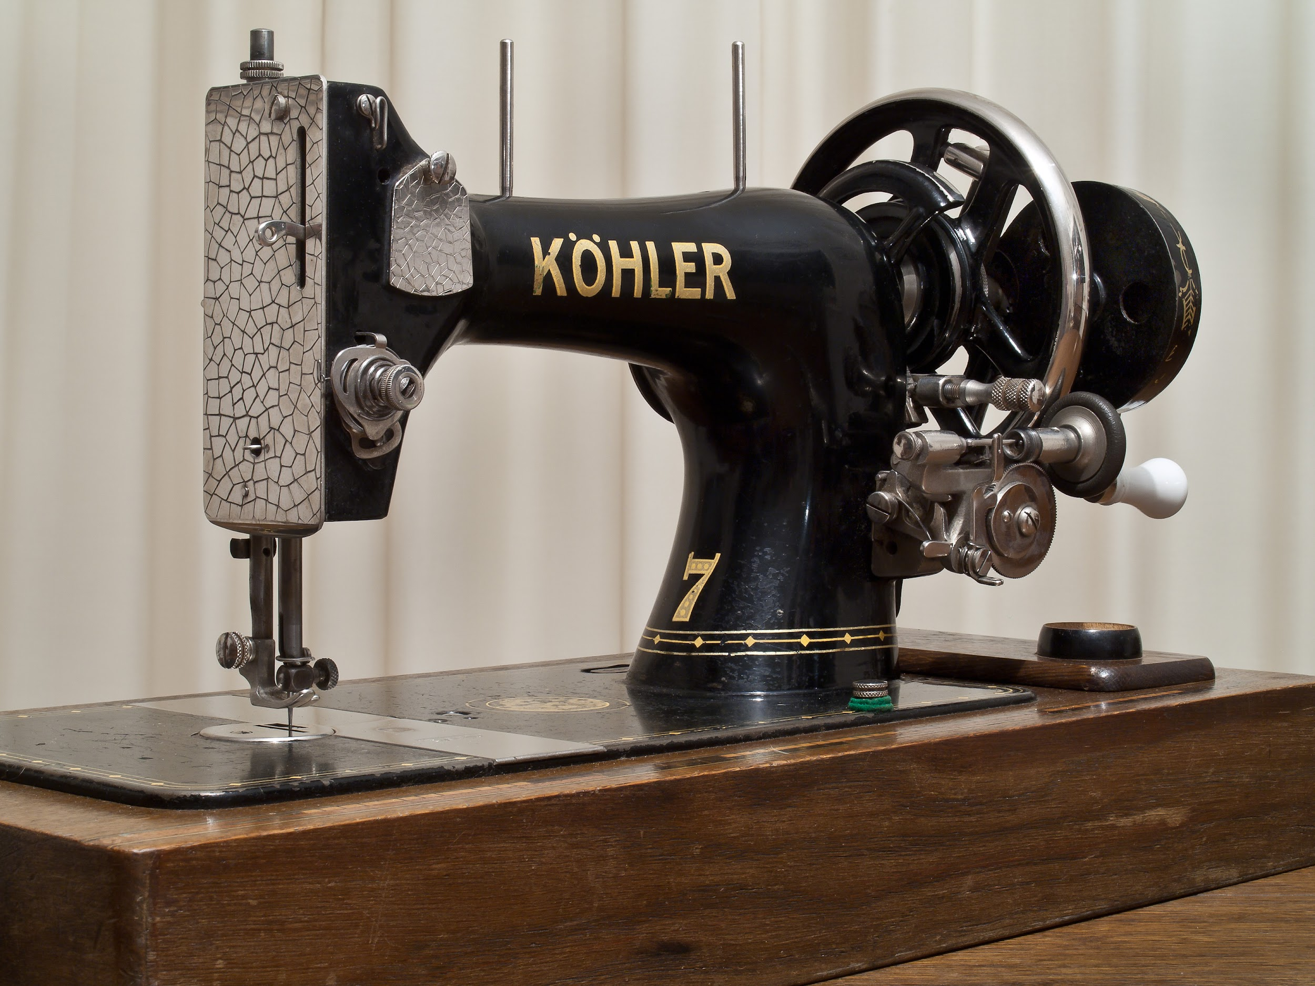
the mechanics of a
SEWING MACHINE
Shreya Goel

Slide 2

The main parts:
1
The belt run by a motor
2
The crankshaft and the lever
3
The oscillating needle
3
The bobbin compartment
STS FALL ‘19 PROGRAMMING
steinhardt.nyu.edu/technology
Notes:
1: The quality of online learning is not on par with on-ground. There might be an assumption that the work is “lighter” and less rigorous.
2: Online Learning can become isolating when not planned or executed carefully. This is sometimes the reason that MOOCs have a large dropout rate.
3: There might be a lack of interaction with NYU faculty and professors might not as easily recognize struggling students.

Slide 3
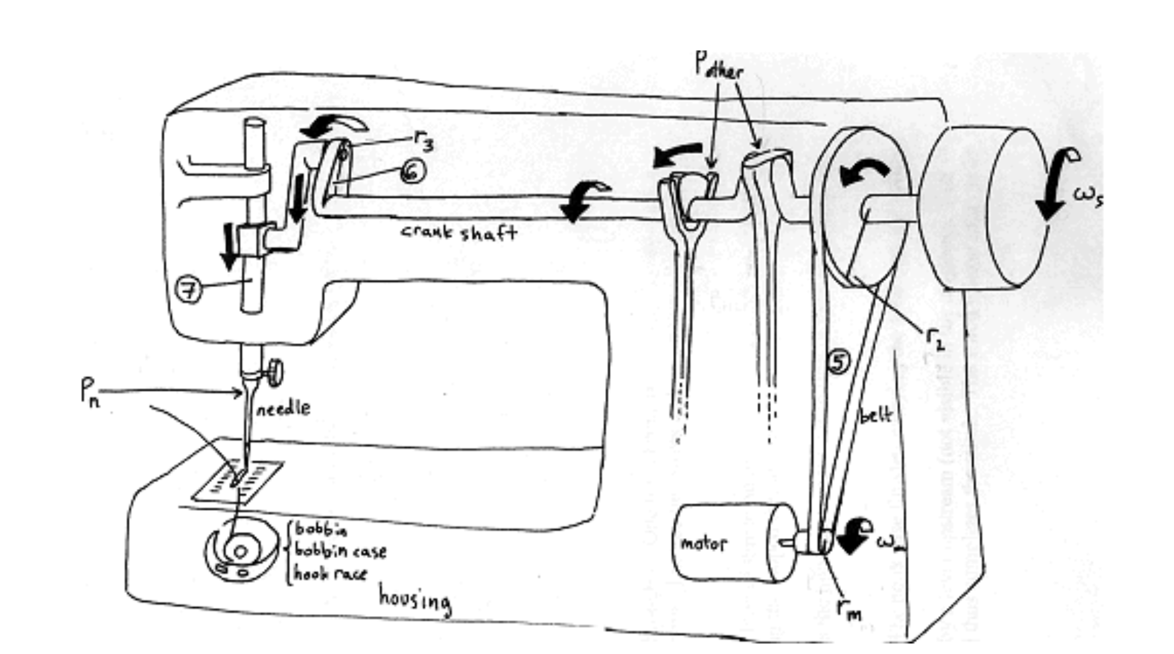
STS FALL ‘19 PROGRAMMING
steinhardt.nyu.edu/technology
Notes:
The main shaft is powered by a belt (5) that runs from the motor.
At the needle end of the crankshaft is a protruding lever (6) that rotates with the shaft.
This bar connects to the lever at one end (6) and the needle rod (7) at the other. Since the needle rod can only travel up and down, the bar transfers only the vertical movement from the lever.
The needle oscillates vertically.

Slide 4
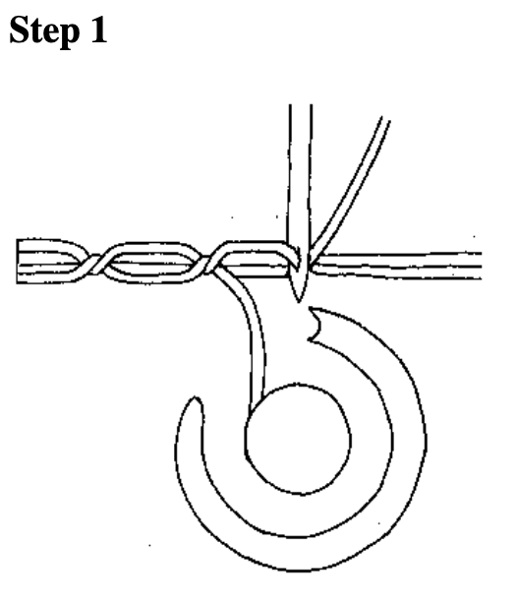
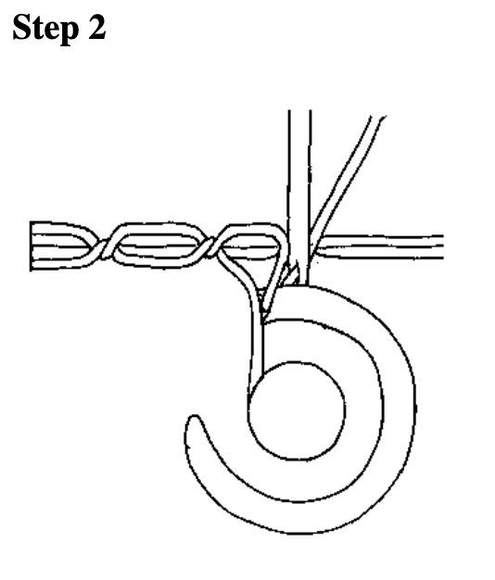
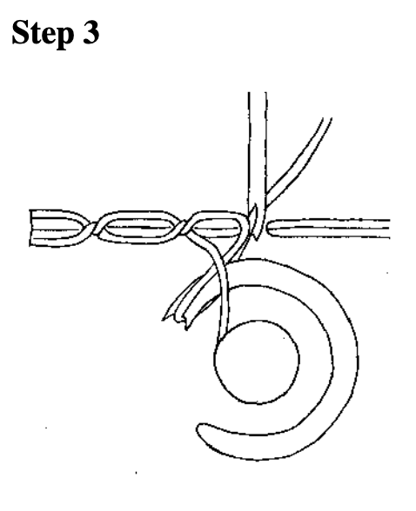
How the stitch works
STS FALL ‘19 PROGRAMMING
steinhardt.nyu.edu/technology
Notes:
The fabric has two threads running through it. One thread runs through the needle from a spool and the other comes from the bobbin. The needle lowers and penetrates the fabric, carrying its thread with it.
The needle begins to lift and forms a loop of thread on the fabric’s under side. As the hook case turns the hook approaches, catching the looped thread.
The needle rises above the fabric. As the hook case continues to turn, it carries the loop of thread.

Slide 5
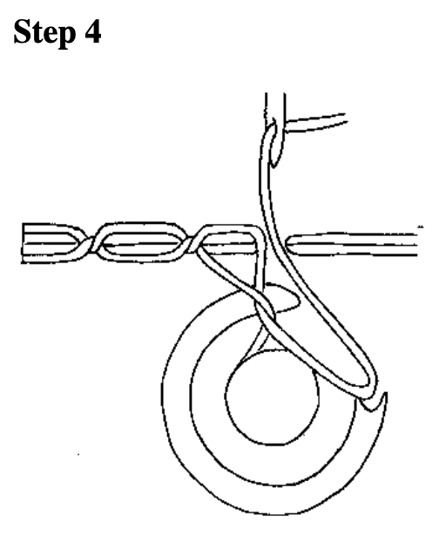
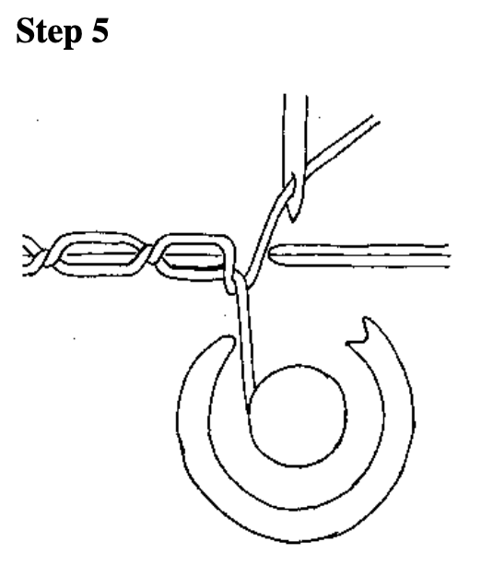
How the stitch works
STS FALL ‘19 PROGRAMMING
steinhardt.nyu.edu/technology
Notes:
The needle is still above the fabric. The hook case finishes carrying the loop over the bobbin.
The needle’s thread is pulled taught by a lever upstream (not visible in the diagram). This action pulls the loop from the hook and thus completes the stitch. The stitch is now ready to be repeated.

Slide 6
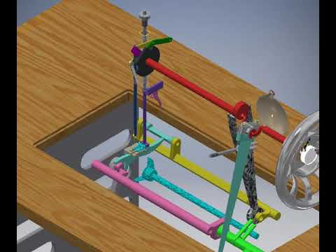
Working mechanism video
STS FALL ‘19 PROGRAMMING
steinhardt.nyu.edu/technology

Slide 7

Unique Features
The stitching mechanism is very unique!
The double crankshaft mechanism for the needle and bobbin movement is inspiring
The way to convert rotational motion to steady linear motion is fascinating
The small to large disc belt mechanism is an interesting way to make a belt
STS FALL ‘19 PROGRAMMING
steinhardt.nyu.edu/technology

Slide 8
Thank You!

